Slide 1
TypeScript
By: Rudhra Koul

Slide 2
Section -1 -:Introduction and Initial Setup

Slide 3
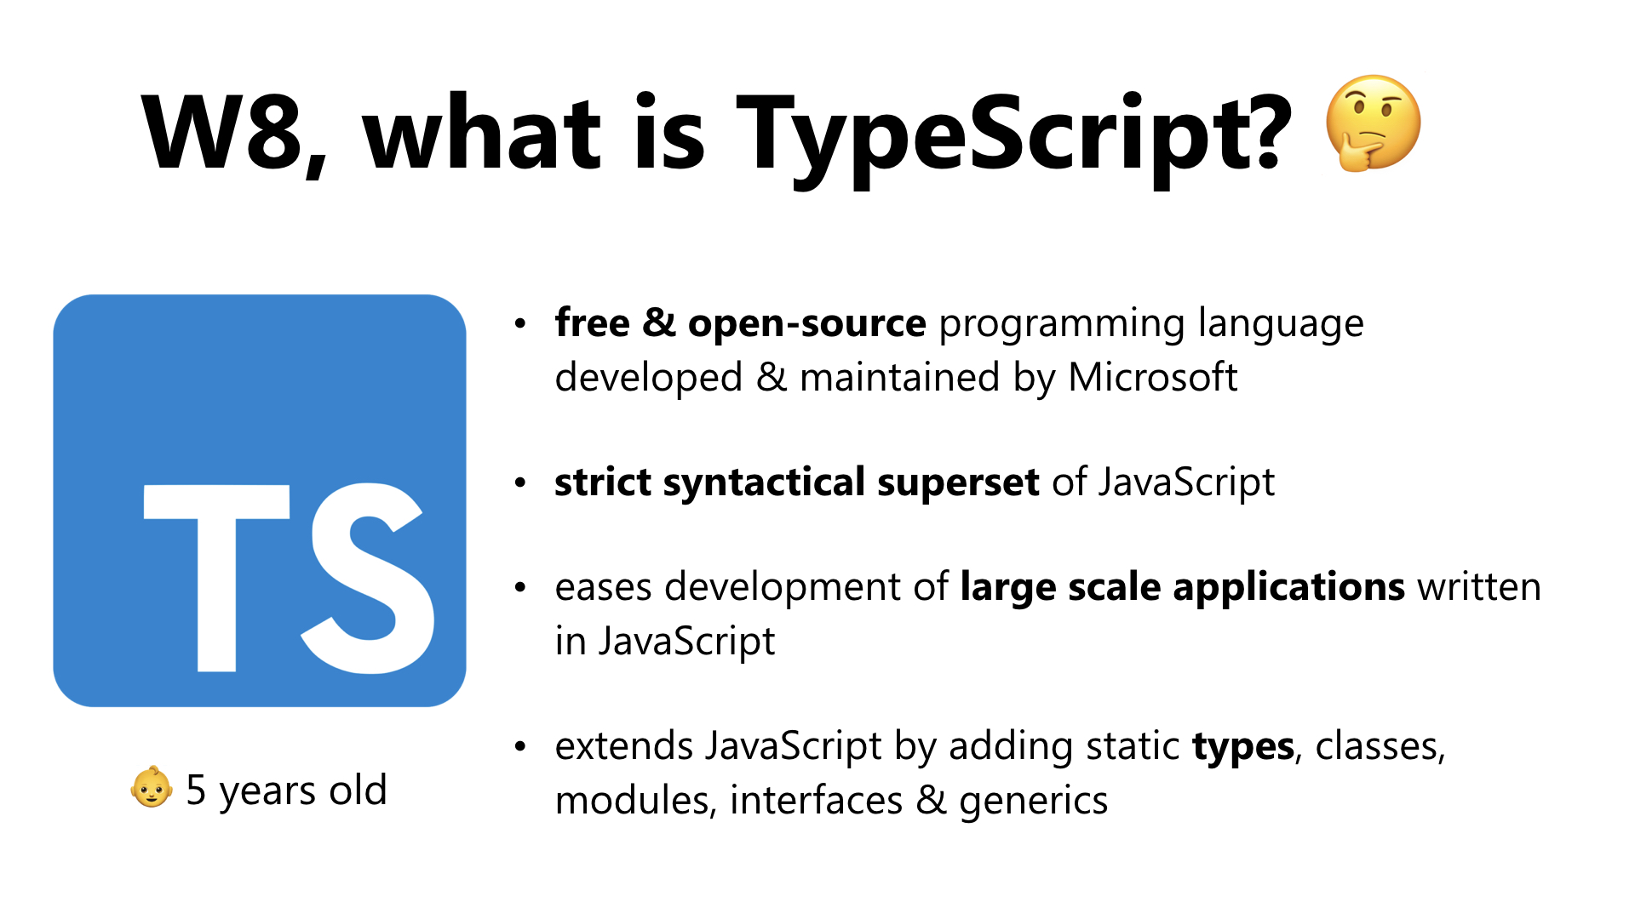
What and Why?

Slide 4
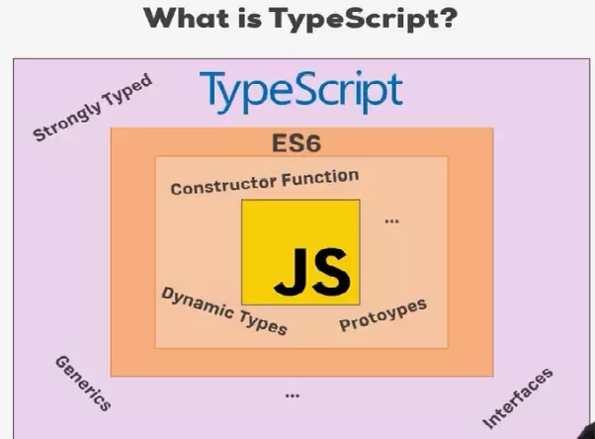
What and Why Cont.… ?

Slide 5
Important Links
Typescript-Official
Typescript-Playground
Nodejs-Download
Vs-Code Download
GitHub-Repository
TsConfigjson-Docs
TsConfig-CompilerOption-docs
TS-ES6-Comparison

Slide 6
Required Setup
Go to nodejs.org and download the latest version - uninstall (all) installed versions on your machine first. Install node-js the setup is fairly simple.
If you already have Node-js and just want to Update npm(node package manager):
npm install -g npm
Install type script:-
Open Node-js command prompt and type below command to install typescript using npm :
npm install -g typescript
Create a folder named typescript-complete-course
Create two files in this folder index.html and app.ts.
Install vs code and open the folder in vs code.
Open a new terminal in vs code by clicking terminal->new terminal or using the vscode shortcut ctrl+shift+`

Slide 7
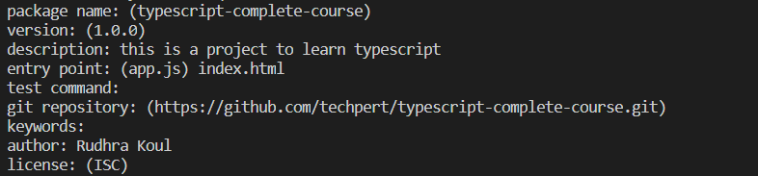
Required Setup cont…
Now lets put this project under the control of node js .This step is required if we want any further dependencies that our project might require to be handled by node.
In the command terminal write npm init
It will ask you a bunch of details which you can provide or else just type enter to accept the defaults. Below is the details I provided for the sample I will use for this training.
This command will create a new file with the name package.json which will contains all details that are needed by node(dependencies, test commands, run commands etc.) and also any dependencies that your project needs will be added here.
Now lets add a simple server that will serve our content on the web browser and will automatically re-render after re-compilation any changes that we do.
Run npm install lite-server --save-dev -:This commands installs lite-server as a devtime dependency using npm.It will add it as a development time dependency to our project by making an entry in the package.json file.We will also notice that it adds a new folder node_modules to our project that will have all the required dependencies.

Slide 8
Required Setup cont…
Now Open the package.json file and add following line to the scripts section.
"start": "lite-server“ :-This section contains the scripts that node runs when we run pm start command we are telling it to tart our little-server on startup.
Now we also want that all our typescript code gets compiled automatically to js and we don’t need to do it for every individual *.ts file. To do that we can also initialize the project with typescript.Run below command in the terminal :-
tsc --init :- This command initializes our project with the help of tsc(type script compiler) and saves its default settings in a file tsconfig.json which will be added to our project
It will ask you a bunch of details which you can provide or else just type enter to accept the defaults. Below is the details I provided for the sample I will use for this training.
To test run this project add a line console.log(‘it works’); to app.ts and add app.ts as a script in index.html by adding <script src="app.js"></script> in <Head> tag.
Open terminal and write npm start
This will open our browser typically n localhost:3000 if it is not busy or else will search a new port and render our project in the default browser on that port.
Now add some text to <body> of index.json we will see it gets updated on the browser and also we will notice our console.log on the console.We will also notice that our app.ts was compiled to app.js
The above project structure has been added to a github repository at following link address :
typescript-complete-course

Slide 9
Section -2 -:Using Types for a better Code

Slide 10
Basic-System-Defined-Types in Typescript
Javascript also has some types like String ,number etc. but we are not explicit about it whenever we create a variable we are not explicit about what type the variable could have should have or may have.
In type script we can be explicit .
Lets see using a demo using branch : type-check-comparison
So what types do we have lets take a look in demo using branch : Basic-System-Defined-Types
Now lets try to understand how it was converted to js in file basicSystemDefinedTypes.js
Now that we have a fair understanding of the basic types lets see some advanced types in a demo using branch : Advanced-Types

Slide 11
Section -3 -:Type Script Compiler

Slide 12
Type Script Compiler : TSC
In this section we will look into multiple tsc options
noEmitOnError:-
Consider an example where we declare a string variable :
let myName: string =‘rudhra’;
myName=20;
This code would give an error as number cant be assigned to a string but if we try to compile the ts file using tsc we would notice it does generate a js file.
This means that the compiler by default only gives a warning.If we want to change this behaviour we can set a compiler option in tsconfig.json "noEmitOnError": true
sourceMap
We already know that we can debug js files in browser but what if we want to debug ts files directly we can do so by setting “sourceMap”:true .This creates an additional file with extension *.js.map which makes our ts files visble in sources in developer options in chrome and we can debug them.

Slide 13
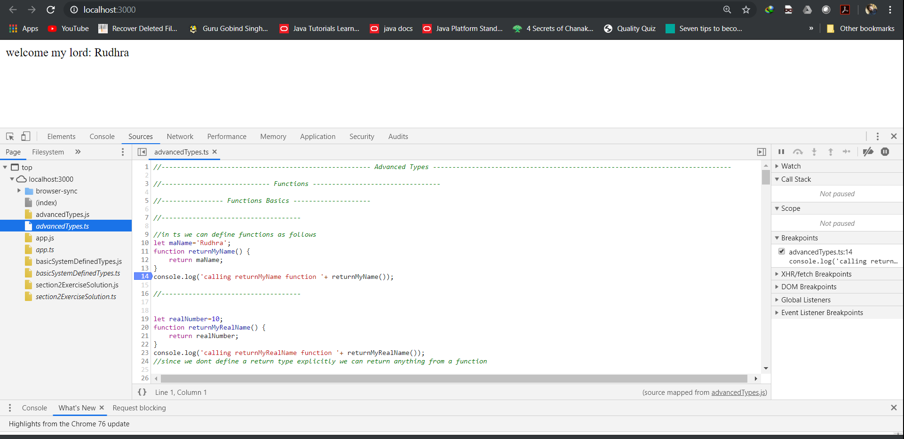
Debugging with sourceMap option in chrome

Slide 14
Type Script Compiler : TSC
noImplicitAny:-
Consider an example where we declare a variable :
let myName;
myName=20;
myName=“rudhra”;
This code would compile fine as ts would implicitly assign it as any,we can change this behaviour using the compiler option noImplicitAny.We can still explicitly set a variable to type any.
target
Specify ECMAScript target version: 'ES3' (default), 'ES5', 'ES2015', 'ES2016', 'ES2017', 'ES2018', 'ES2019' or 'ESNEXT‘
strictNullChecks
Consider the following function:
function controlMe(isTrue: Boolean) {
let result: number;
if(isTrue) {
result =12;
}
return result
}
The above function compiles fine but has an issue if isTrue is set to false result would be null.To make compiler
check this we can use strictNullChecks true option.

Slide 15
Type Script Compiler : TSC
noUnusedParameters :-
Consider the following function:
function controlMe(isTrue: Boolean, isAvailable:Boolean) {
let result: number;
if(isTrue) {
result =12;
}
return result
}
The above function compiles fine but has an issue it has an unused parameter isAvailable .To make compiler check this we can use noUnusedParameters true option.
We can specify any of the available compiler options as an input to tsc command using – in front of it. There are a lot of other options in tsconfig.json. Please refer to the official documentation(Links given on slide 5) for more info.
Demo branch : Typescript-compiler-options

Slide 16
Section -3 -:Type Script and ES6

Slide 17
Typescript and ES6
Typescript allows us to use some of the features of ES6 and the underlying code is converted to ES5 so all browsers support it.
TypeScript does not support all features of ES6.
Below is a link to the comparison of what ts supports and what not :-
http://kangax.github.io/compat-table/es6/
Lets take a look on some of ES6 features using a demo in branch :typescript-and-es6
We also have other ES6 features like symbols ,iterators, generators also supported by type script but they are beyond the scope of this training and should be covered in a dedicated ES6 course

Slide 18
Classes
ES6 introduced the concept of classes which makes working with objects easier.
Type script also has classes and ts classes are more powerful than ES6 classes.
Classes are created with class keyword.
Classes have properties and properties have types. We define properties inside class body and can assign values to them inside the class itself Unlike ES6 where we have to use this keyword and assign values only in constructor.
We can specify access modifiers like public ,private etc. for the properties .By default properties are public. Specifying access modifiers is optional. This is major difference from ES5/ES6 there is no concept of private etc. everything is public there and we have to use some hacks/logics to enforce access modifiers.
Access modifiers available are as follows :-
Public –accessible from even outside the class
Private- accessible only within the class
Protected- same as private but also available via inheritance to child class.

Slide 19
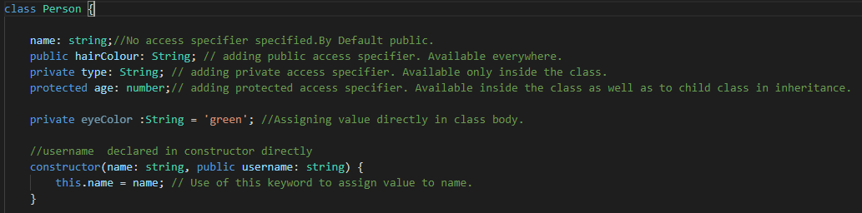
Classes Continued…
We can also provide a constructor to the class and use this keyword to assign values.
We can also declare properties directly inside method parameters in the constructor instead of declaring it in class body and TS is smart enough to understand that it first needs to create such a property in class and then assign value to it. We just have to add the access modifier for such a property in the constructor parameters to achieve this. In such cases we don’t even need to use this keyword to assign value passed to the constructor, to the field, we just declare it as a parameter to the constructor method along with the access specifier.
To use the class we need to instantiate it i.e. make an object using new keyword and store its reference in a variable. We have to pass arguments expected by the constructor.

Slide 20
Class Methods
We can create methods in classes same way we create a function but without using the function keyword.
Methods can also have an access specifier. We can access private/protected properties also since methods are declared inside the class and are thus part of it.
When we want to access properties or modify the values of properties inside methods/constructor we need to use this keyword.

Slide 21
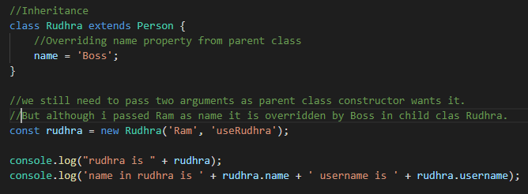
Inheritance
Type Script offers us the feature to extend classes to achieve inheritance.
To inherit a class we use the extends keyword.
Whatever we specify in the child class gets either appended if it was not in parent class or gets overridden if it was already present in parent class.
Private properties and methods are not available in child class.

Slide 22
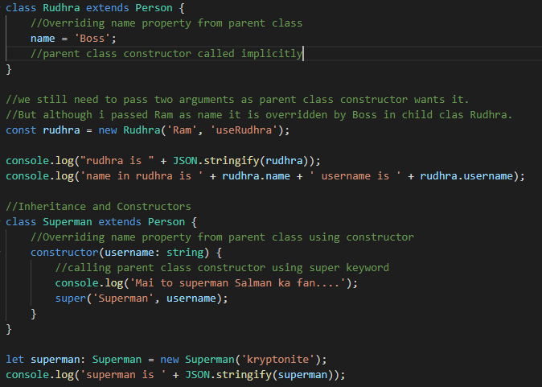
Inheritance And Constructors
If we don’t define a constructor in child class the parent constructor is still implicitly called ,but if we do define a constructor we explicitly need to call the parent constructor using super keyword.

Slide 23
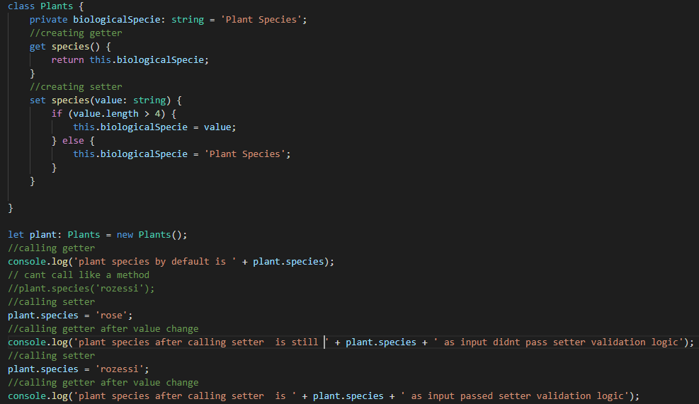
Getters and Setters
In TS getters and setters are exposed as properties not like methods.
We use the get keyword to create a getter and set keyword to create a setter.
We can add any logic to a getter or setter the same way we add it to a method.
Setters take in an argument but getters don’t. Setters cant return a value but getters must always return a value.

Slide 24
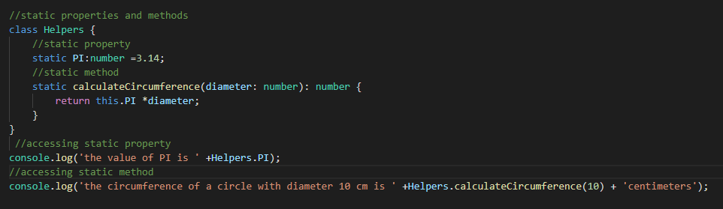
Static properties and methods
Static properties/Methods can be accessed from outside the class without the need to instantiate the class.
Helper/Utility classes are a good example where static properties/Methods can be used.
To create a static property/method we use static keyword.

Slide 25
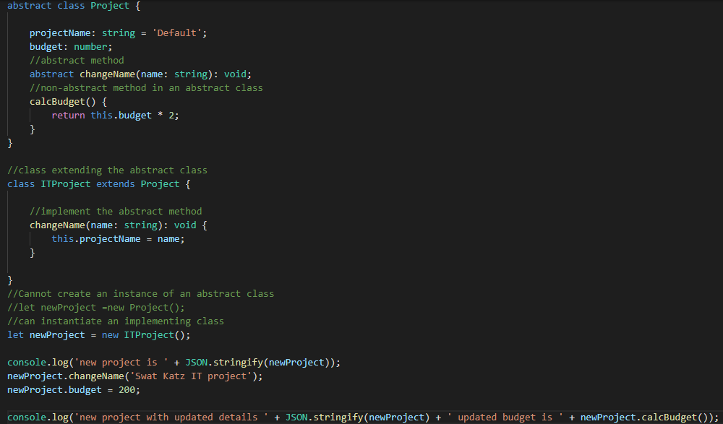
Abstract Classes
Abstract classes cannot be instantiated they can only be inherited.
We use abstract keyword to create abstract classes.
We also have abstract methods which just give method signature no definition and thus skip the { }.
Whenever we extend from a abstract class we need to implement its abstract methods by providing implementation logic.

Slide 26
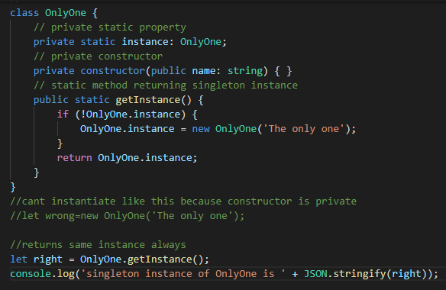
Private Constructors & Singletons (added with TypeScript 2.0)
Type script offers private constructors to create singleton instances of a class.
Such classes cant be instantiated from outside. It exposes a static method that always returns the same instance of the class.

Slide 27
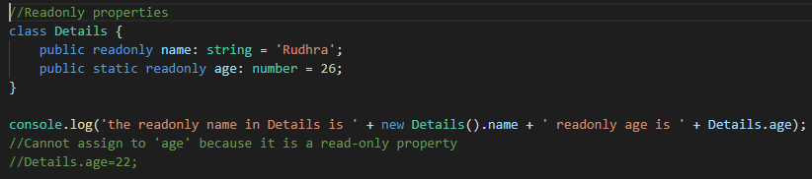
"readonly" Properties (added with TypeScript 2.0)
There are multiple ways to create a readonly property in Ts.
One way is to create a private property assign a value and create only a getter not the setter.
Another shorter way is to add readonly keyword to property declaration.
Demo using branch classes-basics

Slide 28
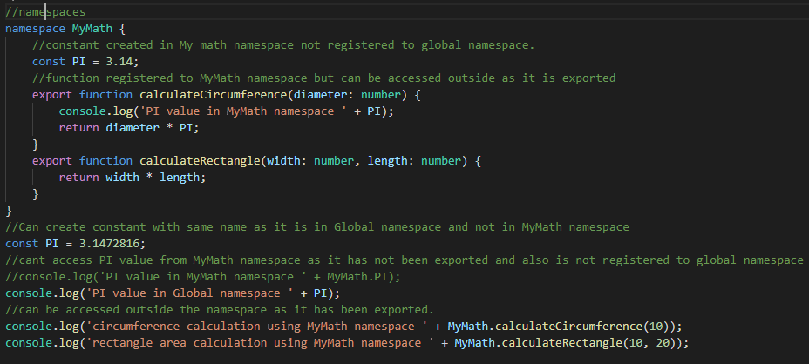
Namespaces
Namespace acts as a logical grouping mechanism for constants,variables,functions and files.
By default everything is registered to global namespace but as and when the size of project increases it becomes difficult to logically group things and can also cause pollution of global namespace.
To solve this ts introduced the concept of namespaces.
Anything declared inside the namespace cant be accessed outside until exported using the export keyword.
Now since the variables etc. are grouped as per namespaces we can repeat the same names if they are in different workspaces.

Slide 29
Demo using branch Modules-And-Namespaces

Slide 30
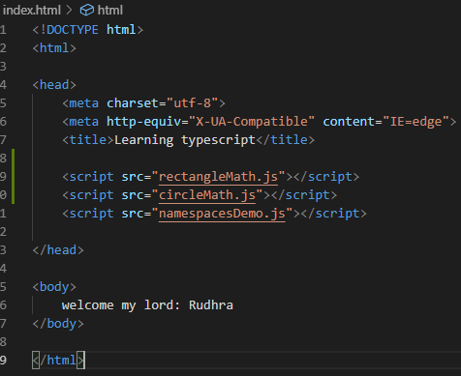
Namespaces And Multiple Files
For larger projects having all logic of a namespace in one file is not possible.
So we need to split our logic to multiple files but still keep them in same namespace.
We can create multiple files and include them in same namespace by keeping the namespace name same.
But since we usually import only one js file in our html the code from others is not included so to solve this we have multiple ways
First one being to include all .js files one by one in our html using multiple <script> tags and that too in order of dependency. The downside is that we need to import all the files but that can get very cumbersome and error prone as and when no of files increase.

Slide 31
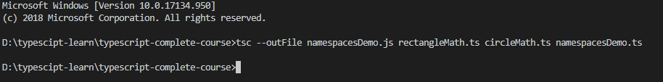
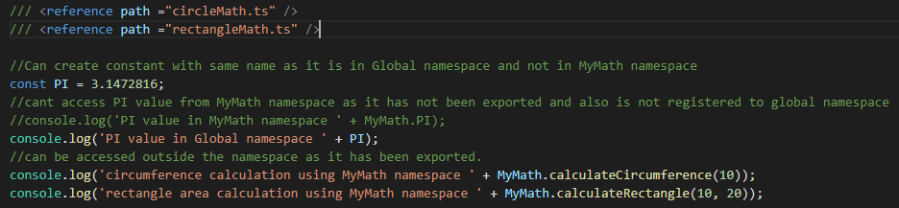
Namespaces And Multiple Files Cont ..
Secondly Tsc allows us to bundle all our files to one single file by compiling using command tsc –outFile <output file name.js> 1.ts 2.ts , output file name.ts…. Here outFile is a switch to tsc telling it to compile all files to one file specified by < output file name.js > and 1.ts 2.ts specify names of dependent files in order of dependency.Now we don’t need to add any additional file to our html but we still need to add files to our tsc command
Thirdly we can add imports to our ts files. These are not ES6 imports ts has its own syntax for namespace imports.We use /// <reference path =“file to import” />.Although we still have to add the outFile attribute to tsc but we don’t have to give the dependent ts files.
We can also add outfile directly to tsconfig.json file.But we need to change module in tsconfig to amd.

Slide 32
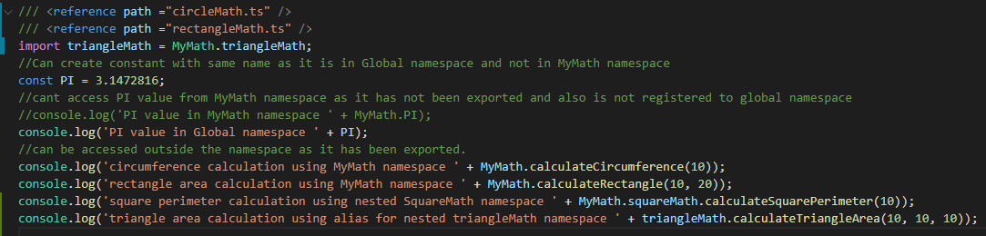
Tips and tricks in namespaces
We can nest one namespace to another.We would then also need to export the nested namespace and while accessing we would have to do something like ParentNamespace.ChildNamespace.member or we can create an alias for the child namespace as Import ChildNamespace=ParentNamespace.ChildNamespace; we can then use ChildNamespace alias directly as ChildNamespace.member

Slide 33
Disadvantages of namespaces
It is not very declarative about which file has which dependency so it becomes cumbersome and unmanageable for large projects.
So while Namespaces are a great tool for small projects but we need to fall back to ES6 modules or Modules in general for medium to large scale projects.
Demo using branch namespaces-and-multiple-files

Slide 34
Modules
To create a Module create a new folder and add files you want to be a part of the module to this folder. Also remember to export any constants or functions that you want to be available when a module is imported.
To import we need to use below syntax import {} from “./folder/tsfile”
We can specify the constants/functions that we want to import in { }. Always remember to skip the .ts extension while importing. Ts by default looks for .ts ,.tsx or .dts files.
Since native javascript doesn’t support modules/import syntax ,we can compile our multiple ts files to multiple js files but we cant import js files into js files.
There are multiple ways to generate module code for js which uses libraries like commonjs,amd etc each with its pros and cons but to use any of these we need a module loader like Systemjs.
Systemjs is a module loader compatible with almost all the available module libraries
To install Systemjs we use command npm install systemjs –save
We need to configure it in index.html

Slide 35
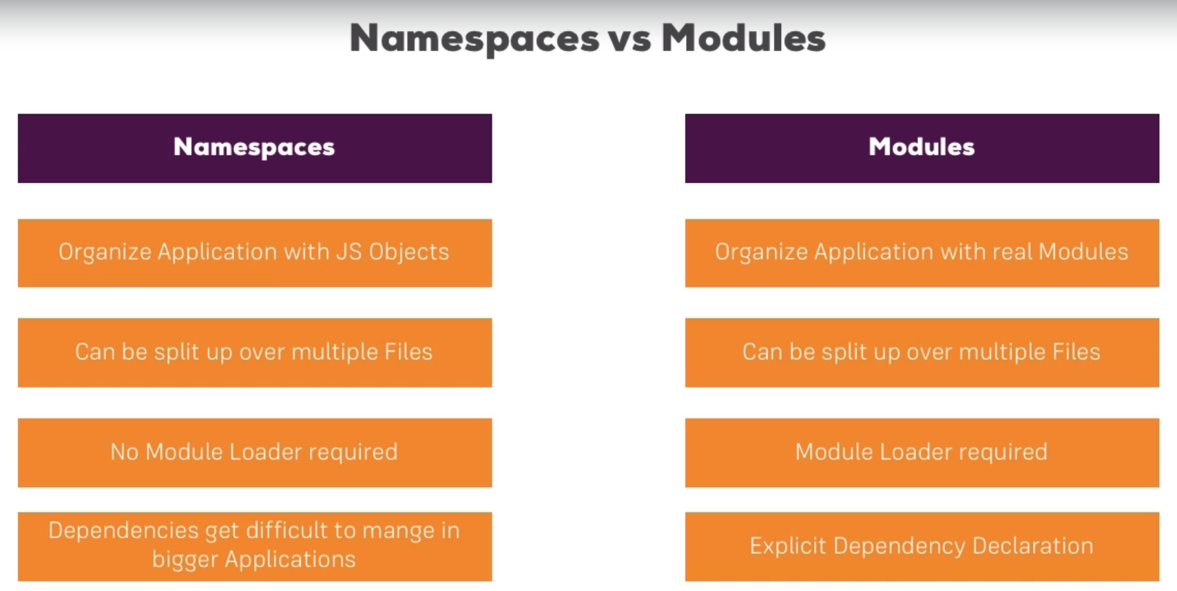

Slide 36
Doing Contract Work with Interfaces
Interfaces are used to define contracts that must be fulfilled.
It helps in enforcing the rule that certain methods or properties must be available for a piece of code to work.
Interfaces don’t get compiled to js code they are just for compilation errors in ts.
Interfaces are created with interface keyword
we can also specify optional fields in interfaces using ?keyword
We can have unnamed properties
Interfaces can be used with methods/classes and function types
One interface can inherit another interface and can also override its field/method.

Slide 37
Thanks!!!!!

